Slide 1

FLDOE Family Portal
Overview and Troubleshooting

Slide 2
Family Portal
The Family Portal is intended as a one stop location for parents to see all of their students’ state assessment scores
Our district has opted to integrate access through a parent’s FOCUS account
State-issued access codes are unique to each student and are loaded into FOCUS by Evaluation Services
This overview will give you some tips on how to handle questions/scenarios from parent users

Slide 3
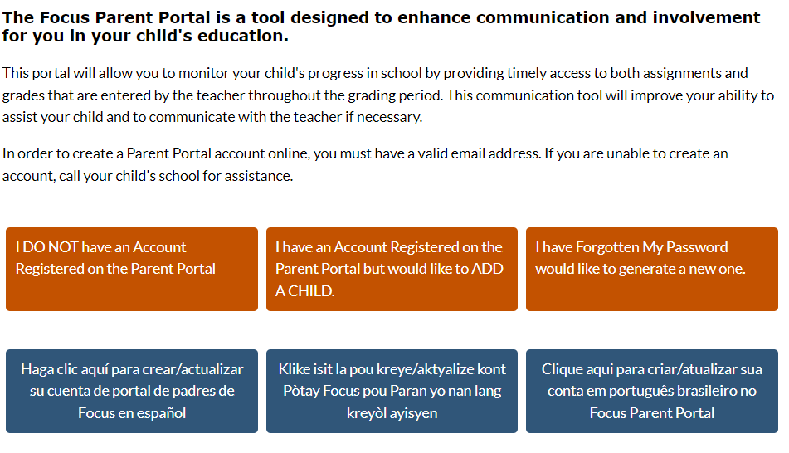
Where to Start
Ensure that the parent has an active parent portal account
If they need to create an account, refer them to the Escambia County Public Schools website
  https://focus.escambia.k12.fl.us/focus/auth/

Slide 4
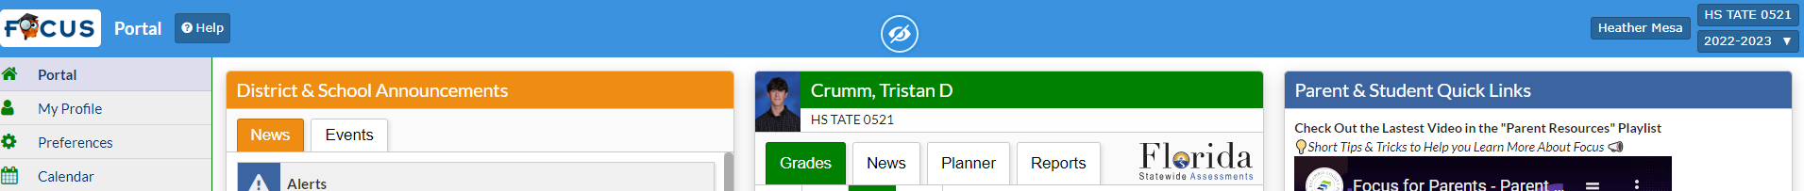
What a parent sees in Parent Portal
When a parent logs into FOCUS, there will be an “Florida Statewide Assessments” icon if their student is entered into TIDE in our district

Slide 5
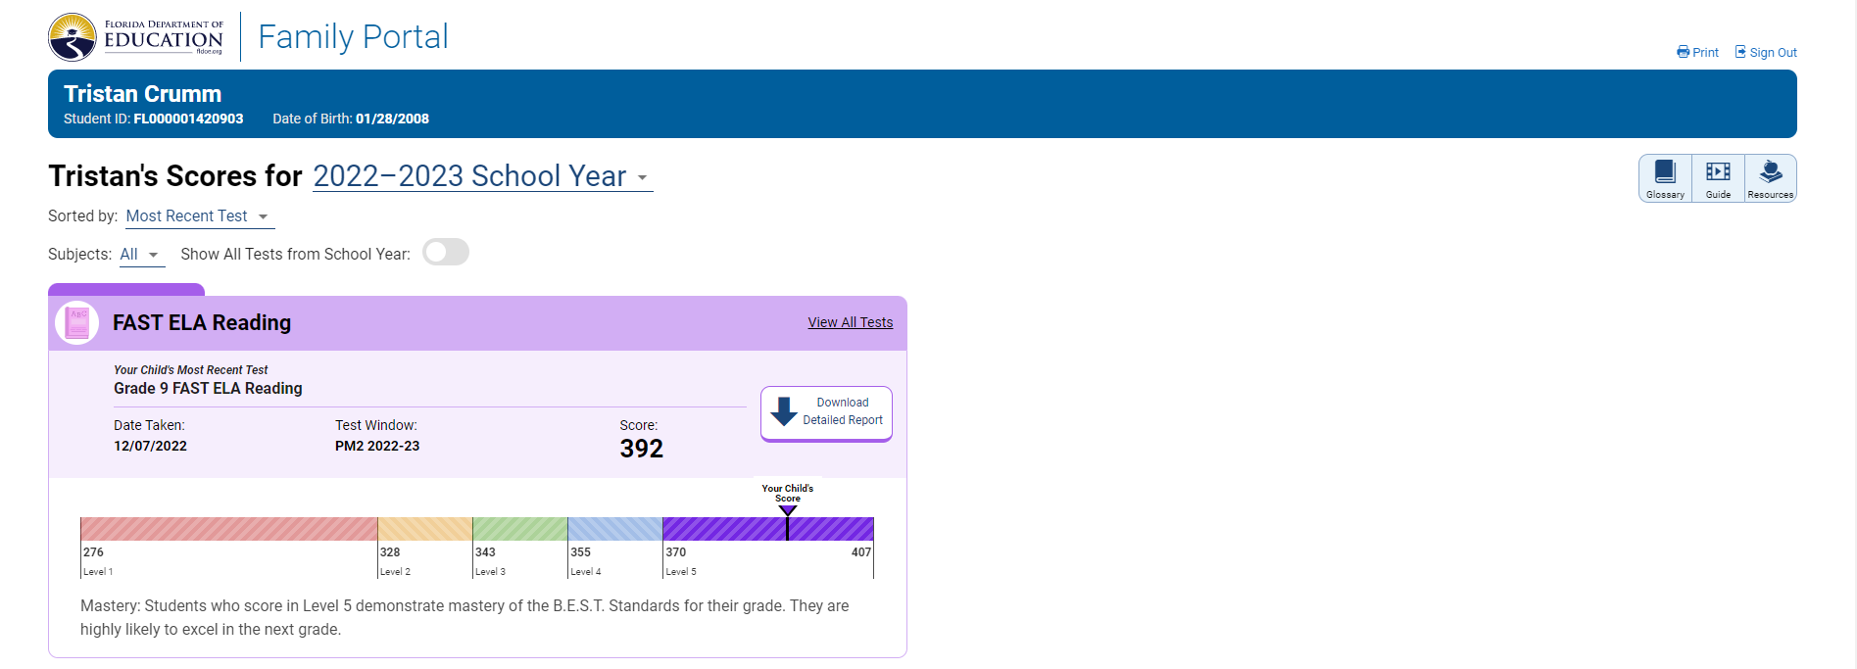
What a parent sees, cont.
When the parent clicks the “Florida Statewide Assessments” link, they are automatically passed into the State’s Family Portal
Parents will be able to see current and past year’s assessments
This will show you the individual student report

Slide 6
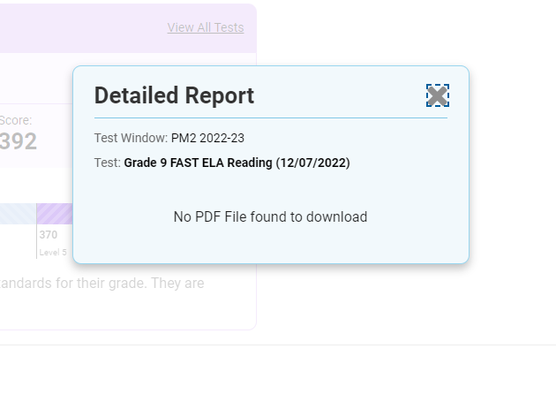
What a parent sees
The parent might see a message that there is no detailed information to see, even though the student’s score is shown.
This is due to the state not releasing the “final” data file for that PM window

Slide 7
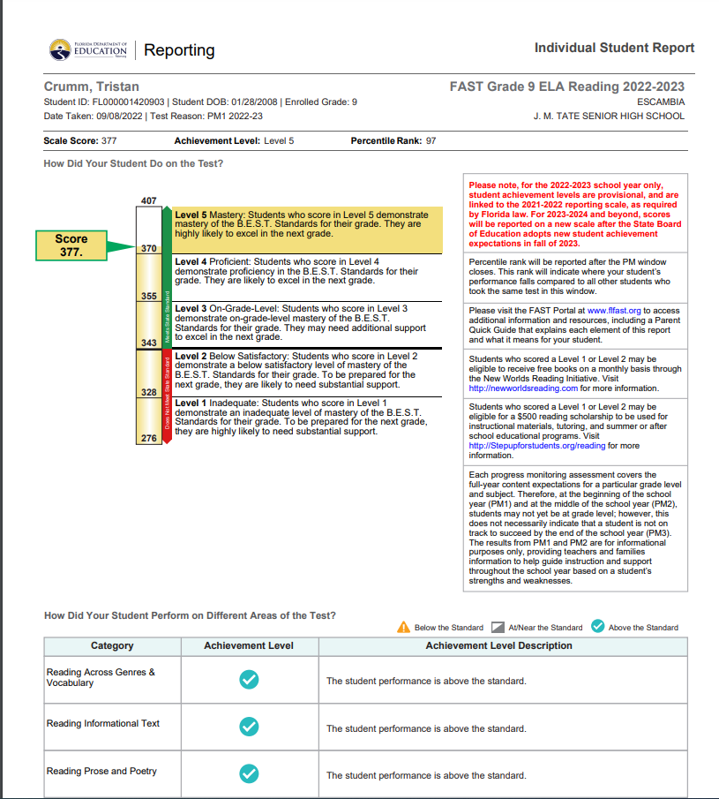
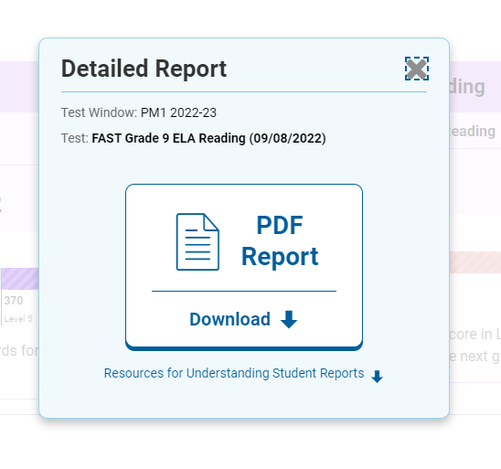
What a parent sees
If the state has released the final data, the parent will see a .pdf of the scores

Slide 8
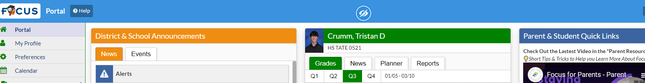
Scenario 1
Parent is unable to see the logo in the parent portal to access scores
Logo is located in the middle section of the FOCUS parent portal home screen

Slide 9
Scenario 1
Possible causes:
Student came from another Florida district or out of state, and has not been entered into your school’s TIDE
Solution:
Enter the student manually into TIDE so the student will receive an access code (especially for previous FL districts)
Notify Evaluation Services so we can update the access code in FOCUS
You can also wait until the next testing window and the new student(s) will be uploaded by Evaluation Services automatically

Slide 10
Scenario 2
Parent can see the Family Portal link, but no current scores are visible
Possible reasons:
  Student did not test during the PM windows, so no scores are available
  Parent is defaulted to “Current Scores” instead of “View all Tests”
Solution:
  Check FOCUS to verify if the student tested in the current PM window
  Have parent change the view to “Show All Test from School Year”

Slide 11
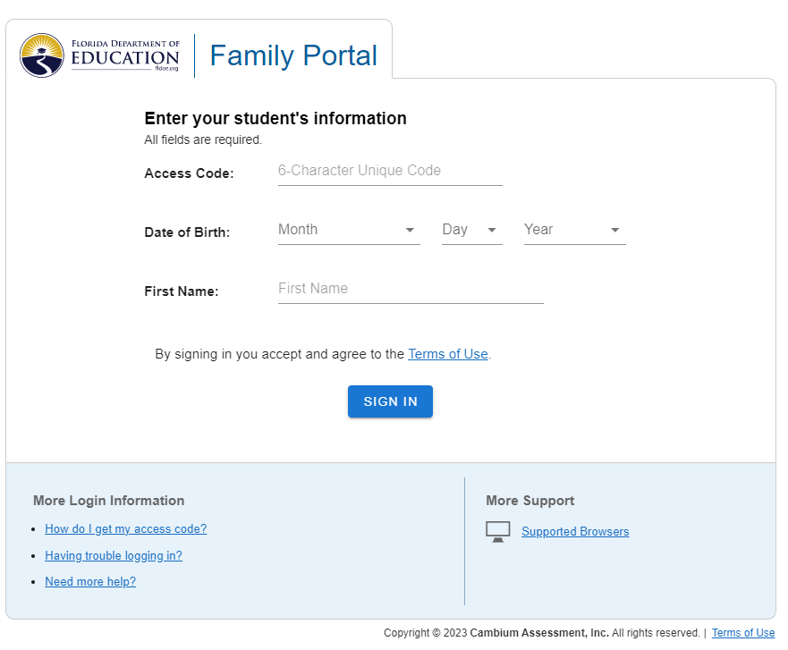
Scenario 2
Parent sees the “Florida Statewide Assessment” link, but then gets this message:

Slide 12
Scenario 2
This is due to either the access code or student’s demographic information changing
If there has been a student demographic change (i.e. name change, FOCUS correction, etc.) verify that TIDE matches what is in FOCUS
Contact the FSATestresults help desk if this does not fix the issue.

Slide 13
Evaluation Services
850-469-5386 (Main)

